Slide 1

NSRIC Inc. (Nature Science Research and Innovation Centre)
Ontario (ON), Canada
Online Education (OE) Division
Consumer Behavior
Instructor: Kathy Chen
Marketing Program, OE Division
NSRIC Inc.
London, ON, Canada
E-mail: kathyjchen18@gmail.com
https://www.nsric.ca

Slide 2
Week 2: Introduction
Content covered in this week:
1.4 Models of purchase: The habit model
1.5 Purchasing models: the level of purchase involvement

Slide 3
Week 2: Introduction
1.4 Models of purchase: The habit model
1. The habitual purchase model
Much consumption is repetitive and habitual, requiring little cognitive thought or resources. People have a habit when they produce the same behavior on encountering a particular stimulus (eg colour, size and shape of the pack).
The habitual purchasing model is characterised by the following:
The response is automatic – no conscious thought (or cognitive resource) is required.
Past experiences in other similar situations might become habitual. This is known as habit repertoire and can be called upon even when making a complex decision.
Although there is no conscious planning before the action, people might reflect on actions after the purchase.
Habitual purchase is frequently satisfactory as it delivers expected results.

Slide 4

Week 2: Introduction
1.4 Models of purchase: The habit model
2. Habitual purchase decisions and loyalty
Loyalty
‘Loyalty’ means faithfulness. It means undeserving devotion. In the consumer context, loyalty consists of two categories:
Attitudinal loyalty
It reflects consumer preference and can be measured through satisfaction surveys, interviews, focus groups, etc.
Behavioral loyalty
It reflects habitual purchases made without much cognitive thought and can be measured by examining purchase or transaction records.

Slide 5
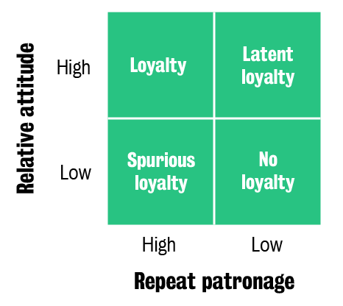
Week 2: Introduction
1.4 Models of purchase: The habit model
2. Habitual purchase decisions and loyalty
Using these two forms of loyalty, Dick and Basu (1994) define a framework with relative attitude (ie, attitudinal loyalty) and repeat patronage (ie, behavioural loyalty) as dimensions. The result is a two-by-two typology with four types of consumer loyalty.

Slide 6
Week 2: Introduction
1.4 Models of purchase: The habit model
2. Habitual purchase decisions and loyalty
Loyalty
A ‘true loyal’ customer is one that has a relatively positive attitude towards the brand and is a repeat customer. For example, many pubs in England have truly loyal customers that simply love the pub, its staff and atmosphere and frequent the pub several times a week.
Spurious loyalty
A ‘spurious loyal’ customer is one that might not care about a brand (ie, low relative attitude), but buys the brand because of some other matter. For example, you might go to the closest supermarket even if you don’t like that supermarket because it is convenient.

Slide 7
Week 2: Introduction
1.4 Models of purchase: The habit model
2. Habitual purchase decisions and loyalty
Latent loyalty
A ‘latent loyal’ customer is one that is hidden from the brand, as they have a high relative attitude but for some reason cannot buy the brand. For example, many people love the Ferrari brand, but only few can actually buy it due to financial resource limitations.
No loyalty
A ‘non-loyal’ consumer does not have an attitude or a relatively negative attitude towards the brand and does not buy the brand at all or frequently. This consumer may be loyal to a different brand or perhaps like to switch between brands. For example, the toilet paper industry does not see a lot of loyal customers as it is close to a commodity and consumers may buy a particular brand only because of a price promotion or convenience (ie, it was the only brand on offer at the corner shop).

Slide 8
Week 2: Introduction
1.4 Models of purchase: The habit model
2. Habitual purchase decisions and loyalty
Habitual decisions and loyalty
East et al. (2005) measured attitude and past patronage and predicted recommendation and retention. The authors shared the following findings:
Attitude predicted recommendation and hardly predicted retention.
Past patronage predicted retention but not recommendation.
According to this study, therefore, different forms of loyalty can be identified:
those that are based on the different cognitive processes
those only loosely related to each other.

Slide 9
Week 2: Introduction
1.4 Models of purchase: The habit model
3. What is customer tenure?
Customer tenure
Behavioural loyalty is measured by the duration of time that people are customers, known as customer retention or customer tenure.
Relationship marketing was defined by Berry (1983) as ‘attracting, maintaining and enhancing customer relationships’. The main emphasis has been on increasing customer tenure by increasing satisfaction, but there are limits to how much satisfaction can be improved in a competitive environment.

Slide 10
Week 2: Introduction
1.4 Models of purchase: The habit model
3. What is customer tenure?
Research on customer tenure
The work of Reichheld’s (1996), Loyalty Effect, claims that it is usually better to promote customer retention rather than customer acquisition because long-term customers:
have no acquisition costs, unlike new customers
buy more
are more resilient to price increases
introduce more new customers (referrals)
are cheaper to handle
stay longer

Slide 11
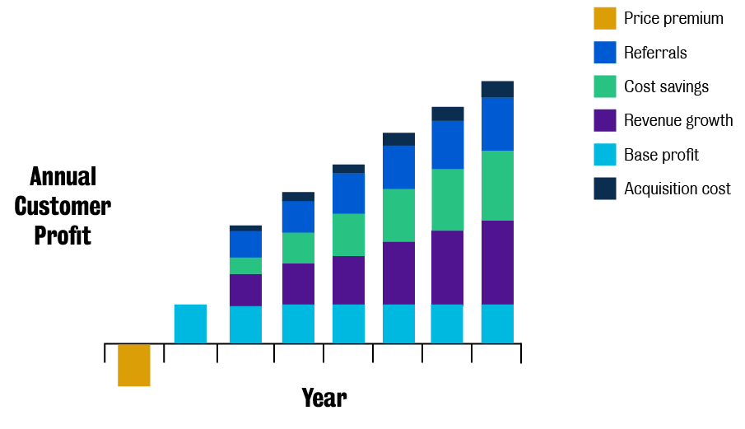
Week 2: Introduction
1.4 Models of purchase: The habit model
3. What is customer tenure?

Slide 12
Week 2: Introduction
1.4 Models of purchase: The habit model
4. Do long-term customers spend more?
The international study (East et al., 2006) shows that tenure has little effect on spending across a diverse set of consumer industries.
It has some positive effects on industries such as credit cards, mobile phone services, and outdoor clothing (denoted by the star symbol *), but in all the other contexts it does not have a significant effect.
5. Are long term customers cheaper to service?
Reinartz and Kumar (2002) found the following:
In some industries, the long-term customers exploited support services more.
A member of a loyalty programme also becomes more costly with tenure with respect to service.
Thus, more knowledgeable customers can be either a benefit or a hazard.

Slide 13
Week 2: Introduction
1.4 Models of purchase: The habit model
6. Do long-term customers recommend more?
Reichheld claimed that long-term customer recommend more, but the evidence is mixed at best. For example, East et al. (2005) found that long-term customers tend to recommend a bit less than short-term customers in retail and financial services, but a bit more in car servicing.
Service (country) Customer tenure and recommendation
Credit card (UK) -.39*
Car insurance (UK) -.36*
Credit card (UK) -.28*
Main supermarket (UK) -.09*
Hairdresser (Mexico) 0.12
Main fashion store (Mexico) 0.18*
Car servicing (UK) 0.20*
Car servicing (Mauritius) 0.20*
Car servicing (UK) 0.25*

Slide 14
Week 2: Introduction
1.4 Models of purchase: The habit model
7. Do long-term customers pay a price premium?
It is not clear if price insensitivity is a function of tenure due to the fact that:
a long-term relationship can obstruct price increases
long-term customers can become resentful when new customers get cheaper deals
Reinartz and Kumar (2002) found that long-term customers did not pay more, were more price sensitive and expected better value.
For example, consider Cindy, who has been a truly loyal customer of a local Indian takeaway where she always buys a very spicy ‘curry with naan bread’ for £8. Recently, the takeaway has increased the price by £1 to cover the increased cost of fresh ingredients due to a dry spell in Spain that has impacted regional supply. However, Cindy feels betrayed by this price increase because she has been a customer for a long time and thinks that £9 for a curry meal is too much to pay, so she shops around and finds a new Indian takeaway at a lower price.

Slide 15
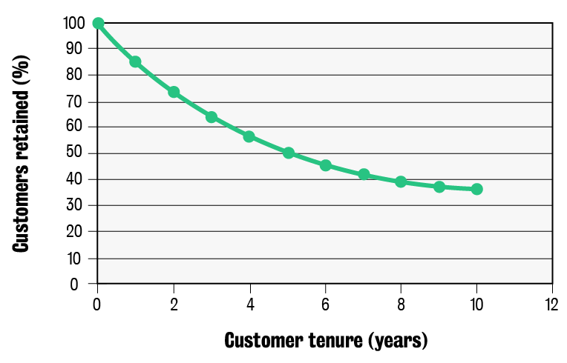
Week 2: Introduction
1.4 Models of purchase: The habit model
8. What happens to customer tenure over time?
Usually, the longer the tenure of a customer, the greater the chance of a customer staying next year. This is not a linear relationship and is why marketers and brands do so much to retain their current customers.

Slide 16
Week 2: Introduction
1.4 Models of purchase: The habit model
8. What happens to customer tenure over time?
This question will be discussed in the seminar:
Why is this trend graph important?

Slide 17
Week 2: Introduction
1.4 Models of purchase: The habit model
8. What happens to customer tenure over time?
What can we conclude about customer tenure?
In sum, Reichheld’s (1996) propositions are not well supported. In specific industries, some propositions hold that long-term customers recommend more. For example, this is the case of the car industry, where long-term customers are more likely to recommend buying a new car. But we may have underestimated the opportunities offered by customer acquisition interest in the value of customers acquired in different ways. Current research finds that referral-acquired customers are better than advertising-acquired customers.

Slide 18
Week 2: Introduction
1.5 Purchasing models: the level of purchase involvement
Most purchases are routine, habitual and controlled by the consumers’ environment. However, purchases that are more novel, important, risky and relevant to the individual get more conscious thought. Let's explore how different types of purchases are distinguished by the level of purchase involvement.
Some textbooks still tend to emphasize rational decision-making and consumer freedom by only teaching the five-step cognitive model for purchase decisions. Well-thought-out decisions are important but rare and often only relevant to new product adoption and brand switching. However, most purchases are routine, habitual and controlled by the consumer’s environment. These two types of purchases are distinguished by the level of purchase involvement.

Slide 19
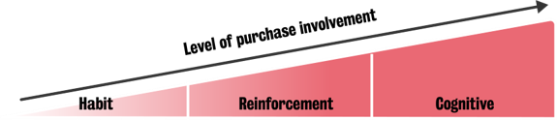
Week 2: Introduction
1.5 Purchasing models: the level of purchase involvement
Purchases that are more novel, important, risky and personally relevant get more conscious thought.
Now, other than the cognitive resources used in the different purchasing models, we have another factor to add: the level of purchase involvement. This is the main driver of why we don’t always rationally decide or consider our purchase decisions.

